Slide 1
Chapter 3:
Project Time Management

Slide 2
Importance of Project Schedules
Managers often cite delivering projects on time as one of their biggest challenges
Time has the least amount of flexibility; it passes no matter what
Schedule issues are the main reason for conflicts on projects, especially during the second half of projects

Slide 3
Project Time Management Processes
Project time management involves the processes required to ensure timely completion of a project. Processes include:
  Activity definition
  Activity sequencing
  Activity duration estimating
  Schedule development
  Schedule control

Slide 4
Activity Definition
Project schedules grow out of the basic document that initiate a project
  Project charter includes start and end dates and budget information
  Scope statement and WBS help define what will be done
Activity definition involves developing a more detailed WBS and supporting explanations to understand all the work to be done so you can develop realistic duration estimates

Slide 5
Activity Sequencing
Involves reviewing activities and determining dependencies
  Mandatory dependencies: inherent in the nature of the work; hard logic
  Discretionary dependencies: defined by the project team; soft logic
  External dependencies: involve relationships between project and non-project activities
You must determine dependencies in order to use critical path analysis

Slide 6
Project Network Diagrams
Project network diagrams are the preferred technique for showing activity sequencing
A project network diagram is a schematic display of the logical relationships among, or sequencing of, project activities

Slide 7
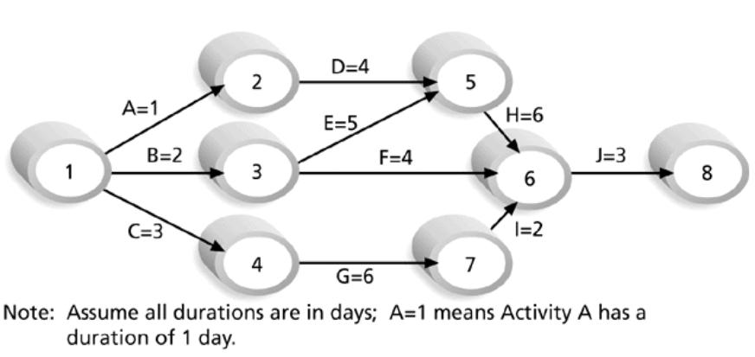
Figure 6-2. Sample Activity-on-Arrow (AOA) Network Diagram for Project X

Slide 8
Arrow Diagramming Method (ADM)
Also called activity-on-arrow (AOA) project network diagrams
Activities are represented by arrows
Nodes or circles are the starting and ending points of activities
Can only show finish-to-start dependencies

Slide 9
Process for Creating AOA Diagrams
1. Find all of the activities that start at node 1. Draw their finish nodes and draw arrows between node 1 and those finish nodes. Put the activity letter or name and duration estimate on the associated arrow
2. Continuing drawing the network diagram, working from left to right. Look for bursts and merges. Bursts occur when a single node is followed by two or more activities. A merge occurs when two or more nodes precede a single node
3. Continue drawing the project network diagram until all activities are included on the diagram that have dependencies
4. As a rule of thumb, all arrowheads should face toward the right, and no arrows should cross on an AOA network diagram

Slide 10
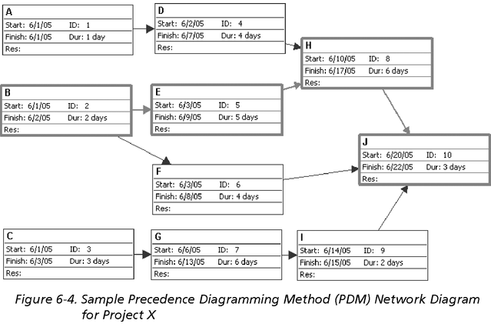
Sample PDM Network Diagram

Slide 11
Activity Duration Estimating
After defining activities and determining their sequence, the next step in time management is duration estimating
Duration includes the actual amount of time worked on an activity plus elapsed time
Effort is the number of workdays or work hours required to complete a task. Effort does not equal duration
People doing the work should help create estimates, and an expert should review them

Slide 12
Schedule Development
Schedule development uses results of the other time management processes to determine the start and end date of the project and its activities
Ultimate goal is to create a realistic project schedule that provides a basis for monitoring project progress for the time dimension of the project
Important tools and techniques include Gantt charts, PERT analysis, critical path analysis, and critical chain scheduling

Slide 13
Gantt Charts
Gantt charts provide a standard format for displaying project schedule information by listing project activities and their corresponding start and finish dates in a calendar format
Symbols include:
  A black diamond: milestones or significant events on a project with zero duration
  Thick black bars: summary tasks
  Lighter horizontal bars: tasks
  Arrows: dependencies between tasks

Slide 14
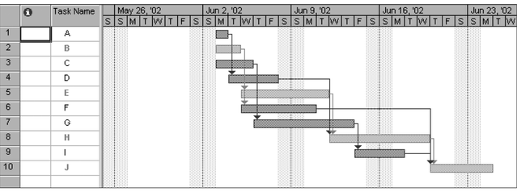
Figure 6-5. Gantt Chart for Project X

Slide 15
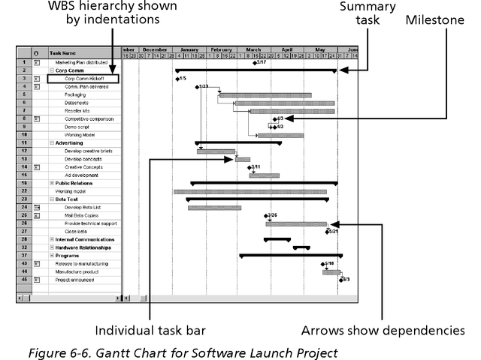
Gantt Chart for Software Launch Project

Slide 16
Milestones
Milestones are significant events on a project that normally have zero duration
You can follow the SMART criteria in developing milestones that are:
  Specific
  Measurable
  Assignable
  Realistic
  Time-framed

Slide 17
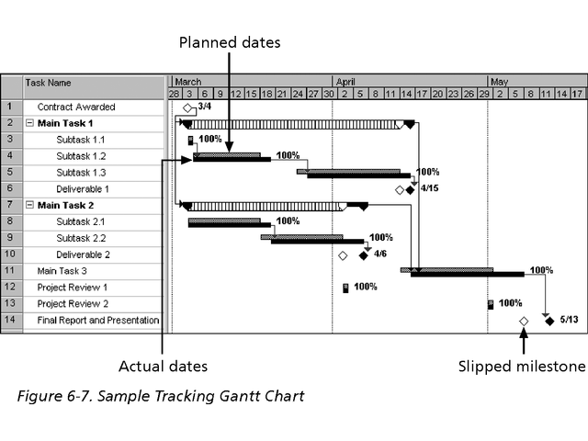
Sample Tracking Gantt Chart

Slide 18
Critical Path Method (CPM)
CPM is a project network analysis technique used to predict total project duration
A critical path for a project is the series of activities that determines the earliest time by which the project can be completed
The critical path is the longest path through the network diagram and has the least amount of slack or float

Slide 19
Finding the Critical Path
First develop a good project network diagram
Add the durations for all activities on each path through the project network diagram
The longest path is the critical path

Slide 20
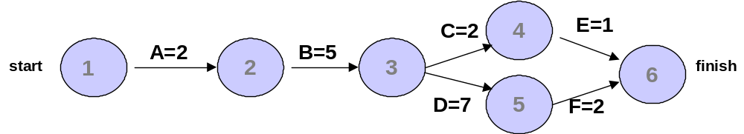
Simple Example of Determining the Critical Path
Consider the following project network diagram. Assume all times are in days.
a. How many paths are on this network diagram?
b. How long is each path?
c. Which is the critical path?
d. What is the shortest amount of time needed to complete this project?

Slide 21
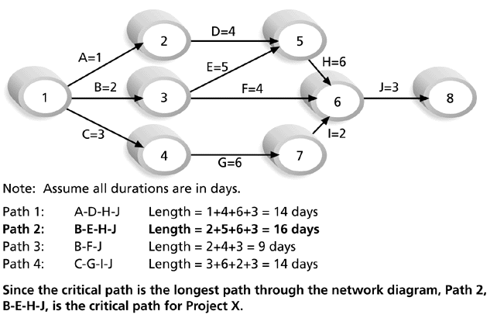
Figure 6-8. Determining the Critical Path for Project X

Slide 22
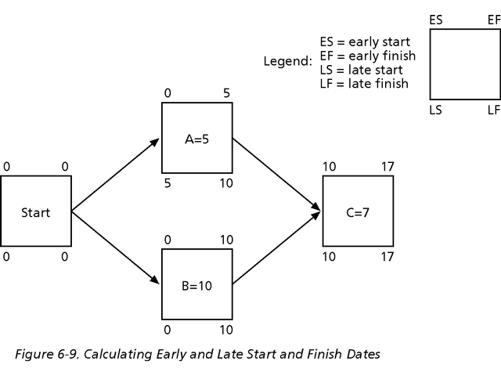
Calculating Early and Late Start and Finish Dates

Slide 23
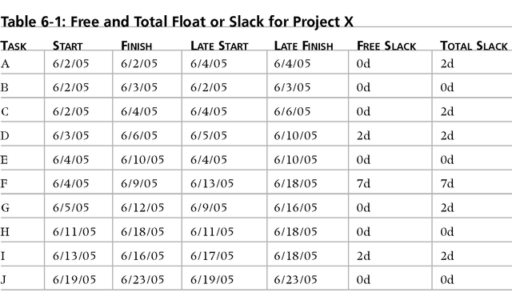
Project 2002 Schedule Table View Showing Free and Total Slack

Slide 24
Controlling Changes to the Project Schedule
Perform reality checks on schedules
Allow for contingencies
Don’t plan for everyone to work at 100% capacity all the time
Hold progress meetings with stakeholders and be clear and honest in communicating schedule issues

Slide 25
Working with People Issues
Strong leadership helps projects succeed more than good PERT charts
Project managers should use
  empowerment
  incentives
  discipline
  negotiation

